Slide 1

Race Briefing
2024

Slide 2

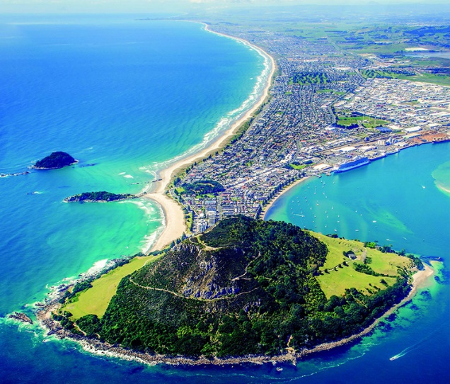
Welcome
On behalf of the team at the Tauranga Triathlon Club we are excited to welcome you all down to Pilot Bay for the GenX/Marra Tinman Triathlon. This year the event is serving as the Tri NZ National Standard Distance Championships and the Tri NZ Para-tri Championships.
No matter whether you are racing for one of the Championship titles, racing in a team, or just giving Triathlon a go, we wish you all a very successful day. Race hard, play fair, and have fun.
Thanks – from the Tauranga Triathlon Club, Tinman Team
  Remember as a participant in this event you are responsible for your own safety and equipment.
  Please obey all traffic rules.
  Please undertake everything you do within the race to your own capabilities and swim, bike and run in a responsible and fair manner.

Slide 3
Entries and Registration
Online entries close on 20th November 2024
Late entries are available at Registration on Saturday 23 November. There is a $20 late entry fee.
Registration
Registration will take on Saturday 23 November at:
  MyRide, 37 Totara Street, Mt Maunganui - 12pm until 3pm
If you can’t make it at that time, then there will be limited availability to collect your race pack at the venue on race morning between 6:00 and 7:00am. Please contact the Race Director on 027 270 5300 or email events@triathlontauranga.org.nz to make arrangements for this.
Note that no late entries will be taken on race morning

Slide 4
Parking
Please note that there is no parking:
    On The Mall
    On Adams Ave
    On Marine Parade
  Please do not park in these areas or your vehicle may be towed away.

Slide 5
Briefings
This document has all the information you need to know and will act as your full race briefing for the event. It must be read by all participants
There will be a short safety briefing presented before race start for each race.
There will be course maps and schedules on display at the venue
Note also that for those wanting to check out the swim course in advance there will be an chance to swim at the venue at 8:30am on Saturday 23rd November. There will not be any water safety present for this & attended at your own risk.

Slide 6


Key Times
Sunday
6:00am Transition Open
7:00am Transition Closed for Standard
7:15am Race Briefing for Standard Tri
7:30am Standard Distance Men (U45) Start
7:32am Standard Distance Men (45-59) Start
7:35am Standard Distance Women (U55) Start
7:37am Standard Distance Men (60+) Start
7:38am Standard Distance Men (55+) Start
7:45am Standard Distance Teams Start

Slide 7
Key Times - Continued
Sunday
8:45am Transition closed for Short Course
9:00am Race Briefing for Short Course
9:15am Short Distance Youth Boys Start
9:17am Short Distance Youth Girls Start
9:19am Short Distance Men Start
9:21am Short Distance Women & Teams
9:30am Splash’n’Dash Race Briefing
9:40am Splash’n’Dash Boys Start
9:42am Splash’n’Dash Girls Start

Slide 8
Key Times
Sunday
10:00am Transition Closed for Sprint and Para-Tri
10:15am Race Briefing Sprint & Para-Tri
10:30am Sprint Male Junior series (U19 only start)
10:32am Sprint Female Junior series (U19 only start)
10:37am Sprint Men Start
10:42am Sprint Women Start
10:45am Sprint Teams Start
10:47am Para-Tri Start
Prizegiving:
This will be held approximately 15 minutes after the last person finishes. We expect this will be at around 1pm

Slide 9

Teamline Swim course
Standard Distance = 1500m – 1 Lap
Sprint Distance = 750m – 1 lap
Short/U16 Youth Distance = 300m along shore
Water temperature average: 19°C
Wetsuits are optional. Snorkels, Flippers or other propulsion devices are not allowed
The swim course will be patrolled by Surf Lifesaving NZ. Raise one arm above your head if you are in distress or need assistance
    Ensure you start in the correct wave
    You must wear the event swim cap on the outside

Slide 10
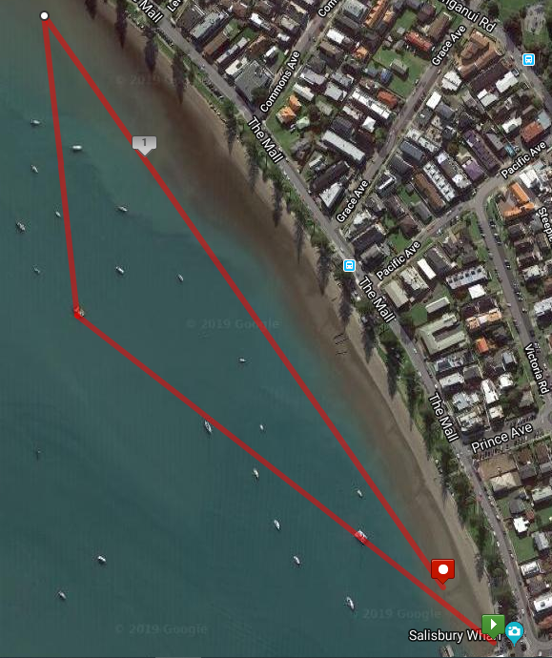

Standard Swim Course – 1 lap

Slide 11
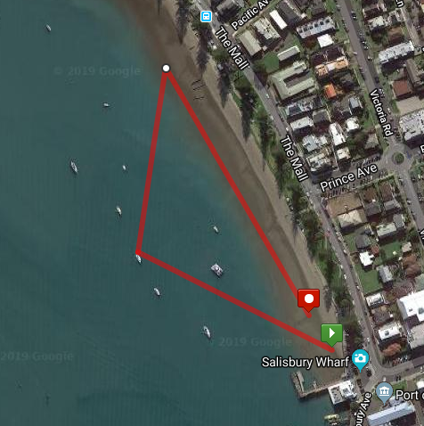
Sprint Swim Course – 1 lap

Slide 12
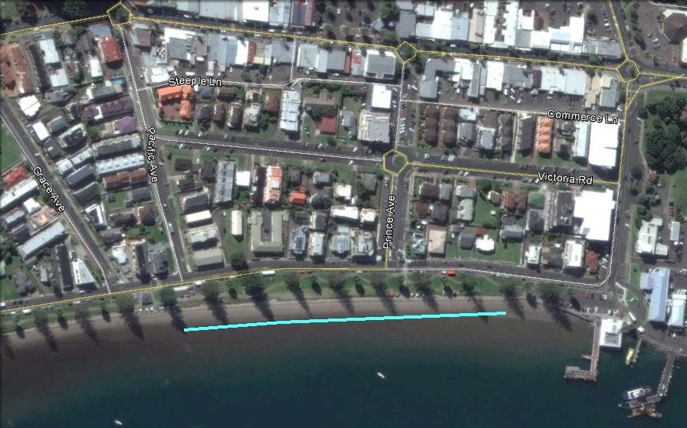
Youth/Short course Swim Course

Slide 13
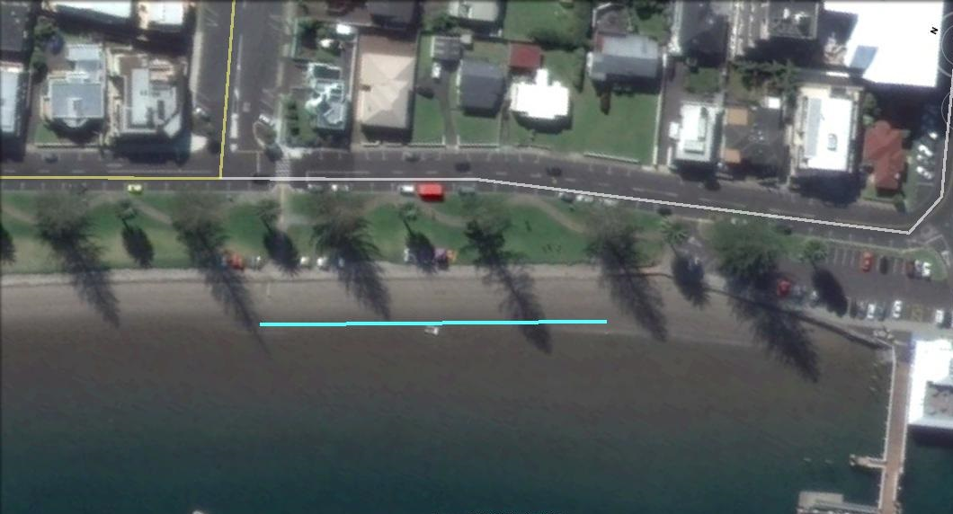
Splash’n’Dash Swim Course

Slide 14
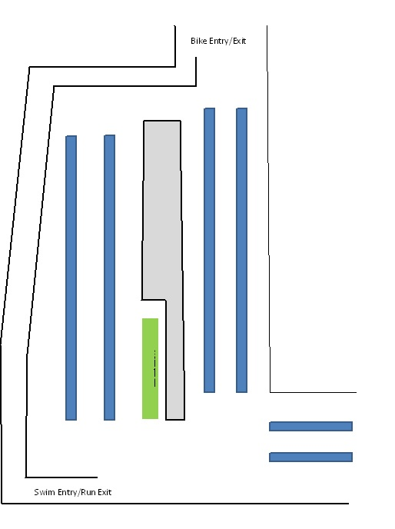

Transition Flow Swim To Bike
MOUNT LINE

Slide 15

Transition Rules
Bike racks are numbered for Standard only – you must rack in your numbered spot. Standard/Short racks are on the road, Sprint/Para in the carpark
Athletes only are allowed in transition – no coaches, family members or supporters
Helmet must be fastened before removing your bike from the rack and remain fastened until you re-rack your bike before your run
Push your bike to the exit and mount beyond the mount line
Dismount before the dismount line and push your bike back to your numbered spot
No boxes or large bags to be left in transition beside your bike – any boxes or bags may be moved by Technical Officials or volunteers

Slide 16
Bike course
Roads are open - Be aware of traffic on the course. Marshals and Technical Officials are managing the course.
Standard Distance
3 laps of 13.33km = total 40km (non drafting)
Sprint Distance
2 laps of 10km (drafting)
Youth & Short
1 lap of 13.33km (drafting)

Slide 17
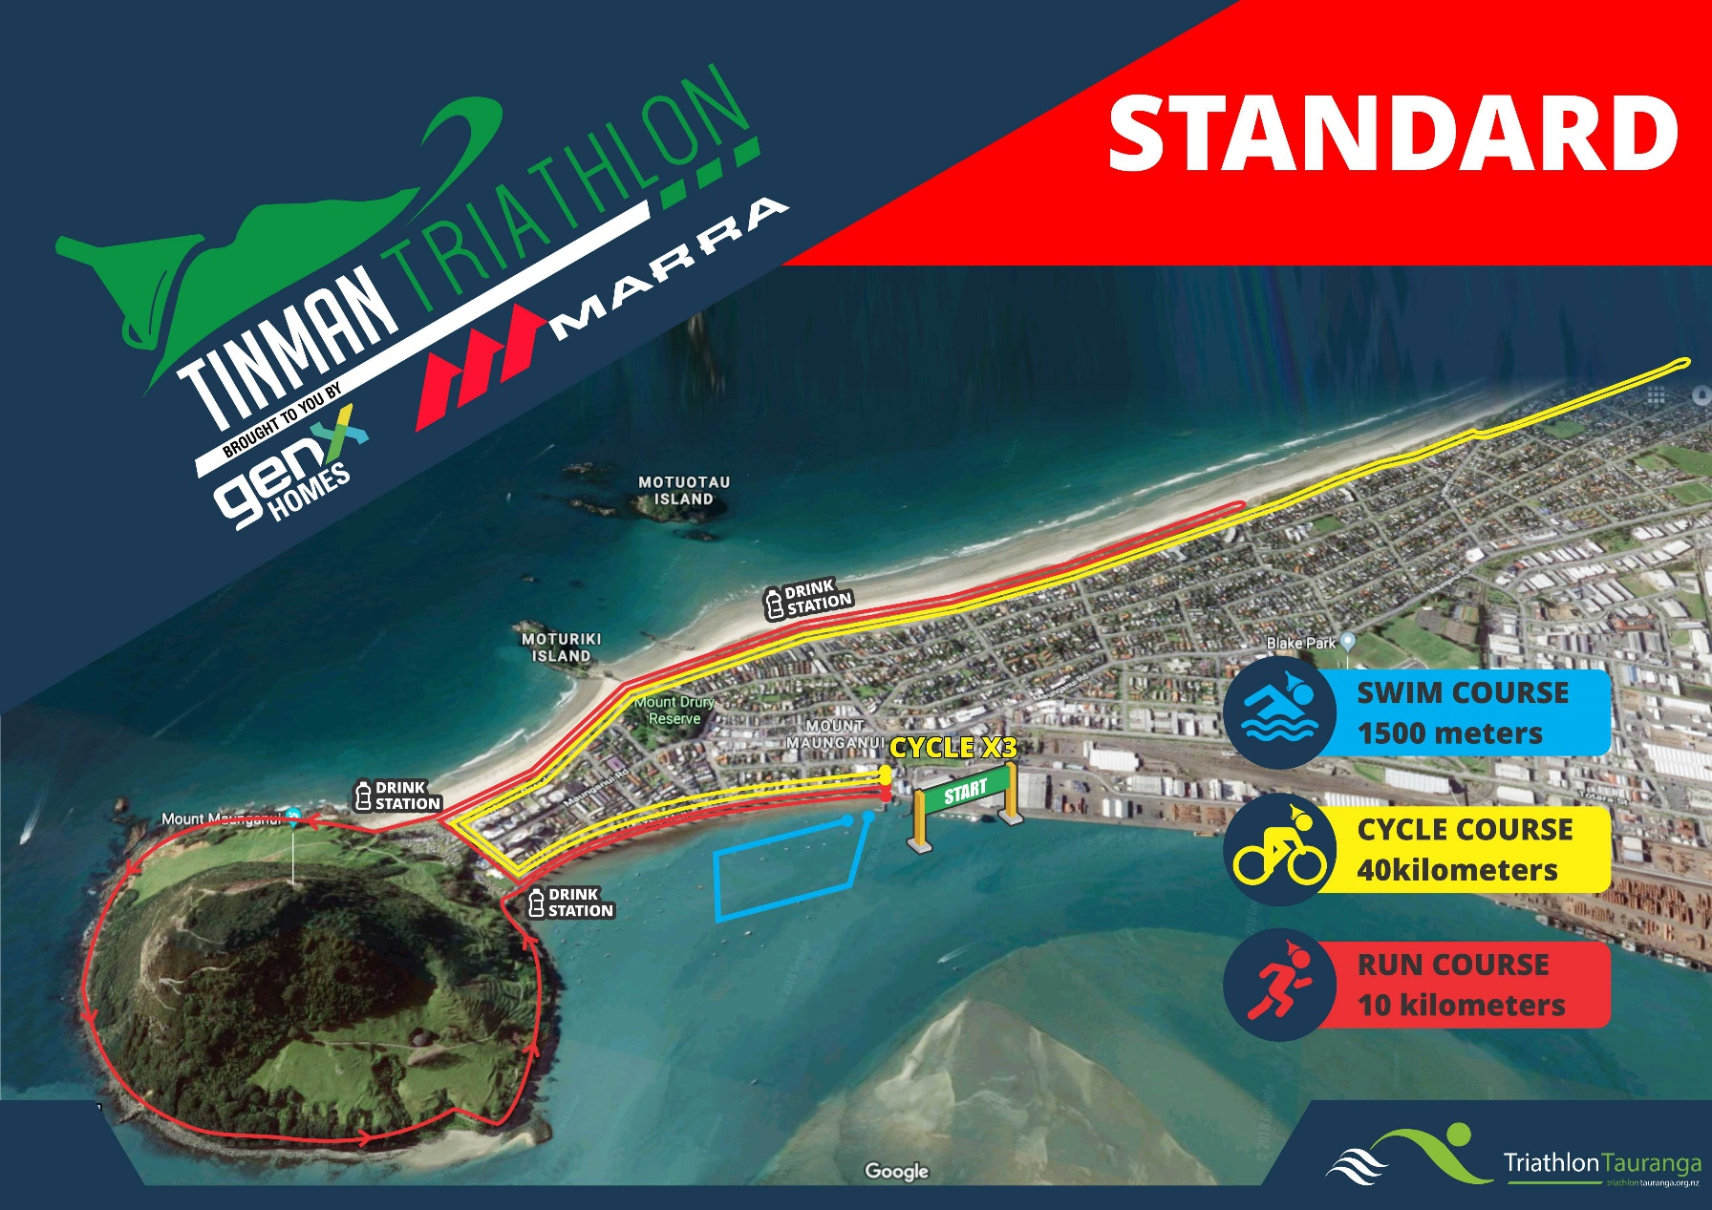
Standard Distance - Course

Slide 18
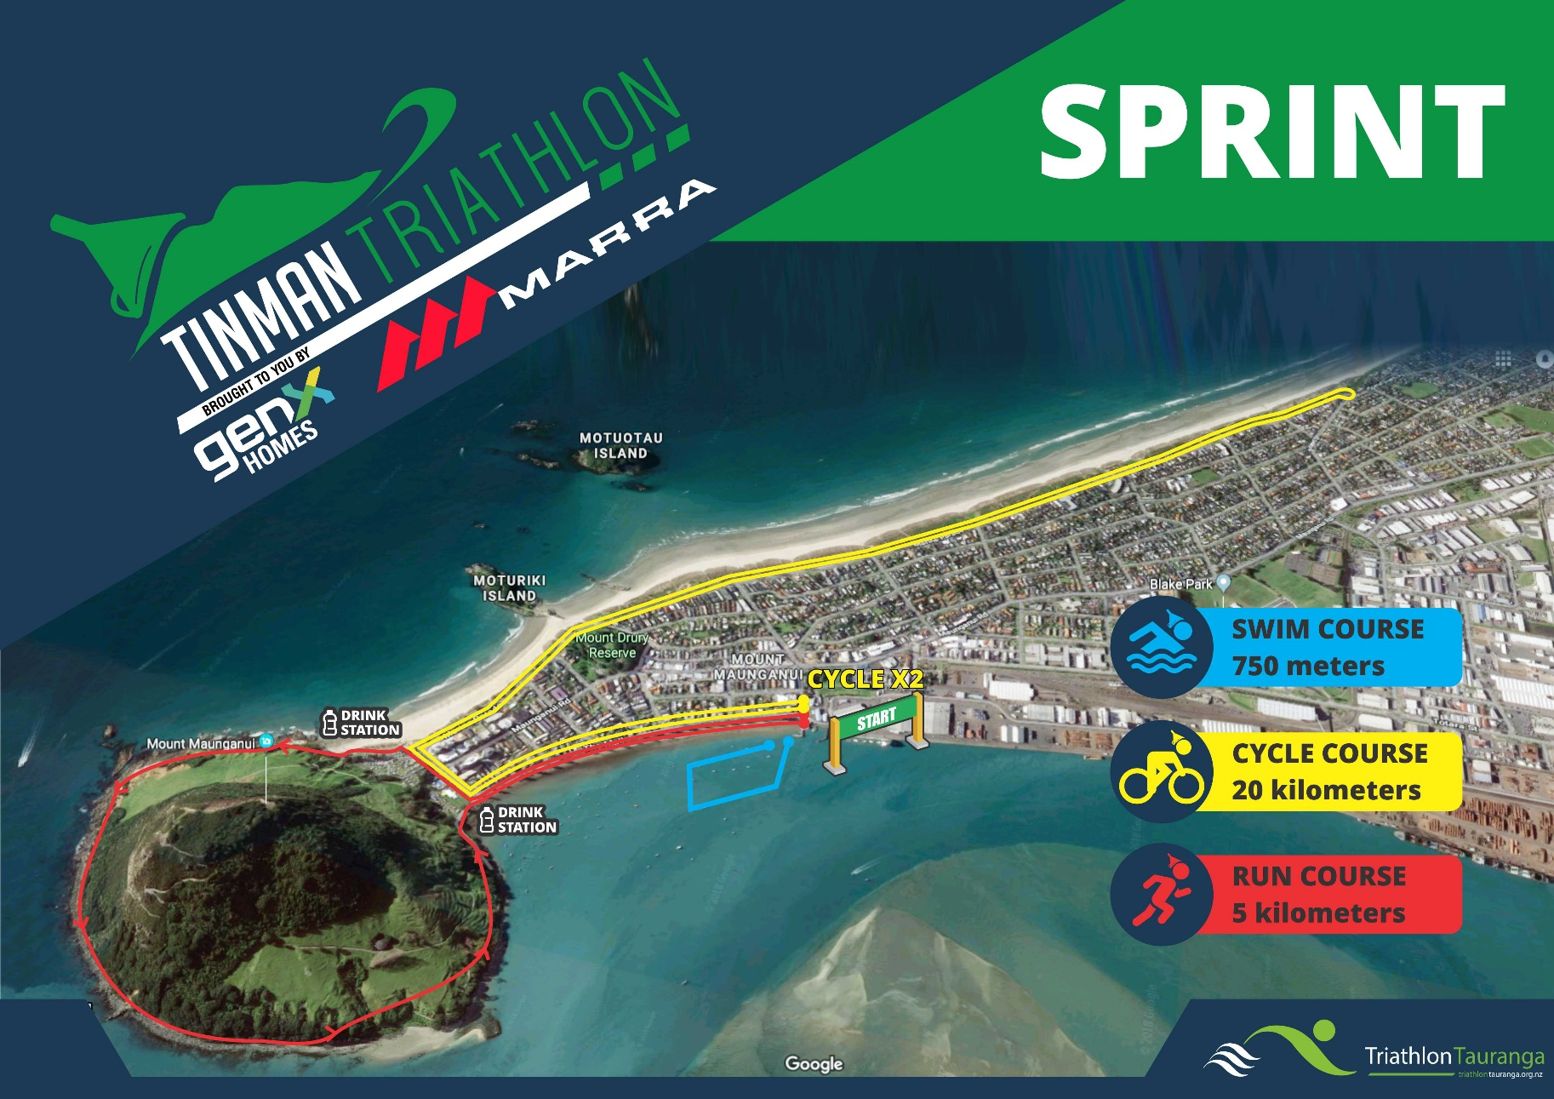
Sprint & Paratri – Course

Slide 19
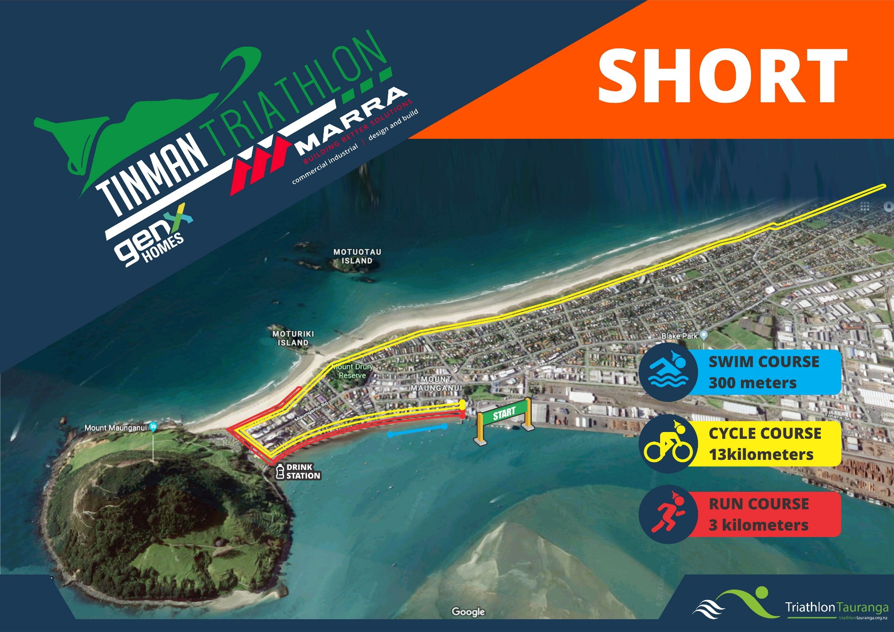
Youth / Short - Course

Slide 20


Splash’n’Dash - Course

Slide 21

Cycle Rules
The key cycle rules are as follows:
Normal road rules apply. In particular – keep as far left as possible and DO NOT cross the centre line.
You must NOT pass on the left
If you do not keep as far left as possible, you risk a penalty for blocking.
The Standard Distance & Short Course races are DRAFT-ILLEGAL races
The Draft zone is 10 metres long by 3 metres wide. You have 20 seconds to complete your pass
Technical Officials will be present on motorbikes for ALL events

Slide 22

Cycle Rules…continued
If you are given a drafting penalty, you will be stopped on the roadside to serve the penalty
Short course race for the Junior series will be NON Drafting.
Drafting Penalties are as follows:
  Standard Distance = 2 minutes
  Served on the roadside where TO instructs you to safely stop.
Cycle Rules

Slide 23
Cycle Rules…continued
Sprint race is Draft-legal.
Although the race is draft-legal you may still be penalised for Blocking if you fail to keep left as far as practical.
There can be NO drafting between genders
Time Trial bikes are NOT permitted in the Junior series races or Sprint. Check next slide for permitted equipment
Note that this restriction does NOT apply to the Paratriathlon. The Paratriathlon is a Draft-Illegal race. The penalty for drafting in this race is 1 minute.
Cycle Rules

Slide 24
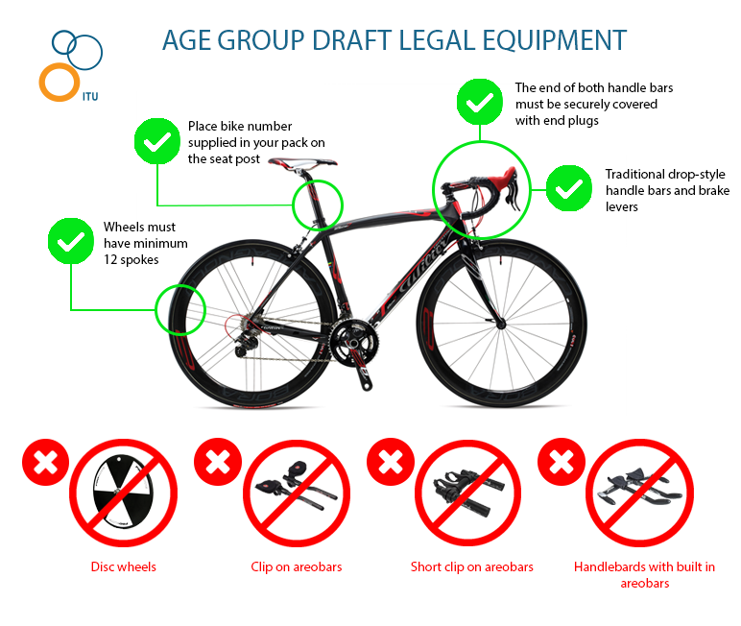

Cycling Equipment – Sprint/Junior series U16&U19
Cycle Equipment

Slide 25

Transition Flow Bike To Run
DISMOUNT LINE

Slide 26

Run course
Standard Distance
1 lap of 10km. The Mall, Adams Ave on the footpath, Marine Parade to the turn, return, onto Mt Basetrack, The Mall to finish
Sprint Distance
1 lap of 5.5km. The Mall, Adams Ave on the footpath, onto Mt Basetrack, The Mall to finish

Slide 27
Run Course
Paratriathlon
1 lap of 5km - All Para-Tri athletes will complete a flat 5km road run. The Mall, Adams Ave on the footpath, Marine Parade, to turn, returning along same roads to finish.
Short Distance
1 lap of 3km. The Mall, Adams Ave, Marine Parade to turn, returning along same roads to finish.

Slide 28

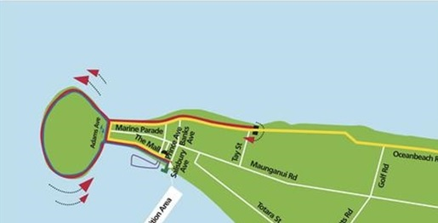

Standard Distance – Run Aid Stations

Slide 29
Sprint – Run
Aid Stations

Slide 30
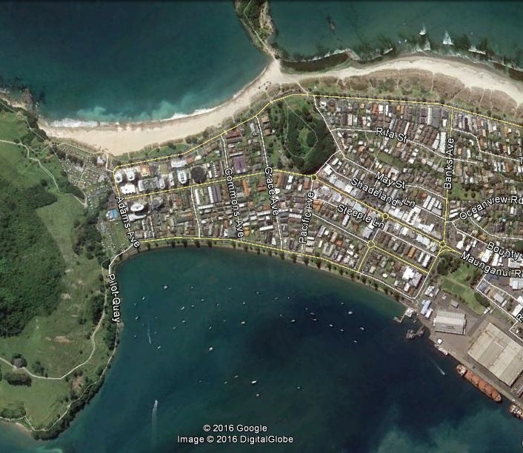
Para-Tri – Run Aid Stations

Slide 31
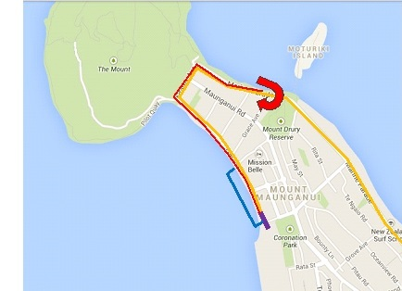
Youth / Short course – Run Aid Stations

Slide 32

Run Rules
You must not discard equipment, wrappers, water bottles by handing it to supporters or dropping them on the ground
You cannot take any equipment or food/fluids etc from supporters
You may not be paced by coaches or supporters either on foot or on bikes during the run
No headsets or music allowed
Note you cannot run with a bare torso/chest ref Tri NZ rules in relation to apparel. Teams included

Slide 33

Team Information
You will Tag your team member inside the transition in the Team Tag box near the Port Building
You must swap your timing chip each time you tag
Cyclists - you may have your helmet on in the tag area and leave it on after your ride
You must rack your bike in your spot before you go and hand over the timing chip to your runner

Slide 34
Contingency Courses
While we always hope that the sun will be shining, and the wind stays away – we need to plan just in case; so
If the water is choppy but still safe to swim the water safety team may decide to shorten the swim based on their knowledge and ability to safely manage the athletes. The rest of the event will remain the same
If the water is too rough to swim, the event will become a duathlon event. Participants will complete a run instead of the swim section of the event. The rest of the event will remain the same. (This also applies to water quality issues)
Should we need to make any of these changes, we will inform you at least 30mins before the start

Slide 35

Protests
Protests must be lodged with the Race Referee with 30 minutes of you finishing the race
The Race Referee will be available at the finish line
There is a cost involved in protesting

Slide 36
Other information
Partial road closure – the road can have vehicles on them – be careful!
Caution on speed-bumps on cycle course
In an emergency see one of the marshals who will be able to assist
If you withdraw please immediately advise event personnel and return to the transition area
Prize Giving and the medal ceremony will be held 15mins after the last person finishes which will be around 1:00pm

Slide 37










Thanks to our sponsors!

Slide 38






Good Luck & have a great race!

